Slide 1


CS472-Cyber Security and Cyber Law
Cryptography

Slide 2
Outline
Introduction to Cryptography
Security Goals
Cryptographic attacks
Symmetric key Cryptosystem
Asymmetric key cryptosystem

Slide 3
Introduction to Cryptogrpahy
Cryptography:
It is a word with Greek origin whose meaning is “hidden/secret writing”.
The Oxford Dictionary (2006) defines cryptography as the art of writing or solving codes.
The art and science of keeping message secure from others.
To enable two people to communicate over insecure channel in such a way that opponent cannot understand what is being said.
Mechanism of achieving security by encoding/ converting the original message into some another form in such a way that message becomes unintelligible.
Hard to understand

Slide 4
Continue…
Allows us to scramble/descramble the text in such a way that they would appear meaningless.
To understand the Cryptography:
Number Theory
Probability

Slide 5


“Your Account Details
Id:xyz
Password: hellowrd”
Alice
BoB
Communication without using Cryptography

Slide 6

Opponent
“Your Account Details
Id:xyz
Password: hellowrd”
Alice
BoB
Communication without using Cryptography

Slide 7

Opponent
“hasdj.sadkdoepsmdlaflasd ;dfkasd kd”
Encoding
Decoding
Alice
BoB
Communication with the use of Cryptography

Slide 8
Application of Cryptography
Secure communications
End-to-End Encryption
Storing Data
Storing Passwords
Authentication/Digital Signatures
Time Stamping
Disk Encryption
Digital Signature
Electronic Money

Slide 9
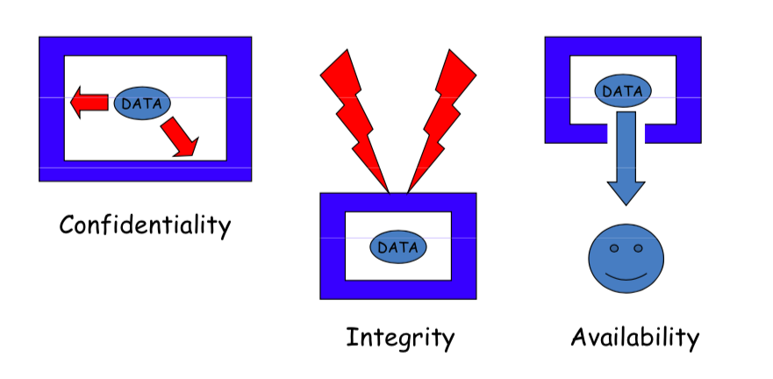
Security Objectives/ Goals

Slide 10
Security Objectives/ Goals
Confidentiality – Information need to be hidden from unauthorized access.
Sender and intended recipient should be able to access the content of the message.
confidentiality means something that is secret and is not supposed to be disclosed to unintended people or entities.

Slide 11
Continue…
Integrity – Protected from unauthorized change.
When the content of the message are changed after the sender sends it and before the it reaches to the intended recipient.
Availability – Available to authorized user when it is needed.

Slide 12
Continue…
Example (Confidentiality) :
In military, concealment of sensitive information is major concern.
In Industry hiding some data/ Information from competitors such as tender details/new product details is critical.
If Alice is sending a message to Bob, it should be impossible or computationally infeasible for Eve to learn the contents of an encrypted message without knowledge of the secret key.
Example (Integrity) :
For example, assume that Alice encrypts a message to Bob by encoding each letter as its position in the alphabet (A=1, B=2, etc.). If Eve can intercept the message, she can modify the message without Bob knowing.

Slide 13
Continue…
Example (Availability):
You have uploaded your all important documents on DigiLocker and at some moment the application is not accessible at the time of need due to heavy load on server.

Slide 14
Security attack:
Any action that compromises the security of information owned by an organization.

Slide 15
Cryptographic Attack
Cryptographic Attack
Cryptanalytic
Non- Cryptanalytic

Slide 16
Cryptanalysis
The science of cracking codes and decoding secrets.
Combination of statistical and algebraic technique to recover a message or secret key from the decoded message without knowing actual message, method of encoding or key.
It is a technique of decoding messages from a unintelligible format without knowing how they were initially converted from intelligible (understandable) format to unintelligible format.
Brute force attack- Attacker tries every possible keys to recover the message.

Slide 17
Non Cryptanalytic
Modification
Denial of Service
Snooping
Masquerading
Threatening to Availability
Traffic Analysis
Replaying
Threatening to Confidentiality
Repudiation
Threatening to Integrity

Slide 18
Non Cryptanalytic Attacks categories
Passive
Active
Snooping
Modification
Masquerading
Traffic Analysis
Replaying
Repudiation
Denial of Service

Slide 19
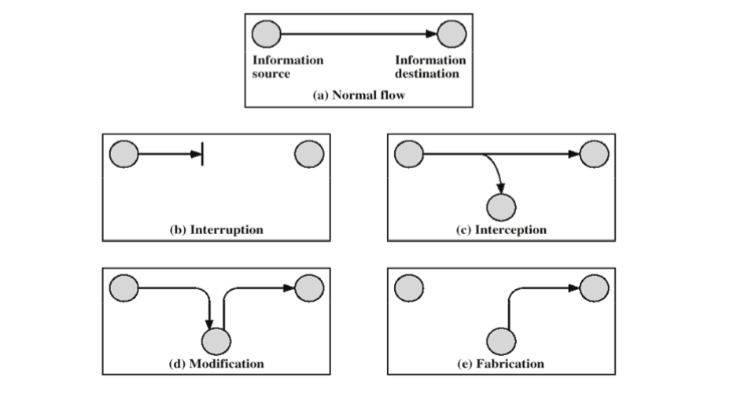
Kinds of Attacks

Slide 20
Passive Attack
A passive attack attempts to learn or make use of information from the system but does not affect system resources.
Passive attacks are in the nature of eavesdropping on, or monitoring of, transmissions.
The goal of the opponent is to obtain information that is being transmitted.
Passive attacks are very difficult to detect, because they do not involve any alteration of the data.
Typically, the message traffic is sent and received in an apparently normal fashion, and neither the sender nor receiver is aware that a third party has read the messages or observed the traffic pattern.

Slide 21
Active Attack
An active attack attempts to alter system resources or affect their operation.
Whereas passive attacks are difficult to detect, measures are available to prevent their success.
On the other hand, it is quite difficult to prevent active attacks absolutely because of the wide variety of potential physical, software, and network vulnerabilities.
Instead, the goal is to detect active attacks and to recover from any disruption or delays caused by them. If the detection has a deterrent effect, it may also contribute to prevention.

Slide 22
Snooping
Unauthorized access to or interception of data.
Example: a file transferred through the Internet may contain confidential information.
An unauthorized entity may intercept the transmission and use the contents for his own benefits.
To prevent the snooping, the data must be made non intelligible to the the interceptor by using some techniques.

Slide 23
Traffic Analysis
Although a data is non-intelligible for the interceptor, but he can still extract some other type of information by monitoring the online traffic.
Example:
Opponent can get email ids of sender and receiver.
By analyzing requests and responses, nature of the transaction can be identified.

Slide 24

Continue…
Unauthorized Entity
Alice
BoB

Slide 25
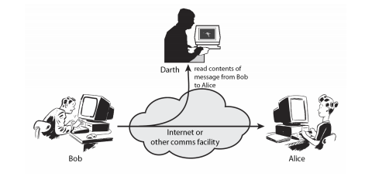
Passive Attacks Traffic Analysis, Release of Message Content

Slide 26
Modification
After incepting or accessing the information, the attacker modifies the information to make it beneficial to himself and send it to the receiver.
Example:
A customer sends a message to as bank to do some transaction. The attacker intercepts the message and modifies the details of transaction to get some benefits.
Sometime attackers simply deletes or delay the message to harm the system or reputation of the sender.

Slide 27
Continue…
Unauthorized Entity
Alice
BoB

Slide 28
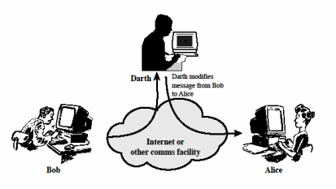
Active attack- Modification of Message Content

Slide 29
Masquerading
Also called spoofing.
The attacker impersonates somebody else.
Example:
Attacker may get bank card and PIN of the bank customer and pretend that she is that customer.
A user tries to contact bank and another site pretends that it is a bank and obtains some information about the user.

Slide 30
Continue…
Unauthorized Entity
Message from Alice
Alice
BoB

Slide 31
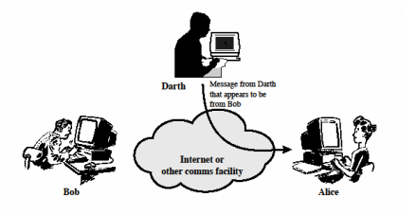
Active Attack- Masquerading

Slide 32
Replaying
Obtains the copy of the message sent by the authorized user and later tries to replay it to create unauthorized effect.
Example:
A person sends a request to her bank to ask for a payment to the attacker, who has done the job for her.
The attacker intercepts the message and send it again to receive another payment from the bank.

Slide 33
Continue…
Unauthorized Entity
Alice
BoB

Slide 34
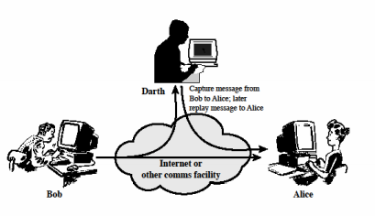
Active attack- Replay

Slide 35
Repudiation
It is performed by one of the two parties in the communication.
The sender of the message might later deny that she sent the message.
The receiver of the message might later deny that he received the message.

Slide 36
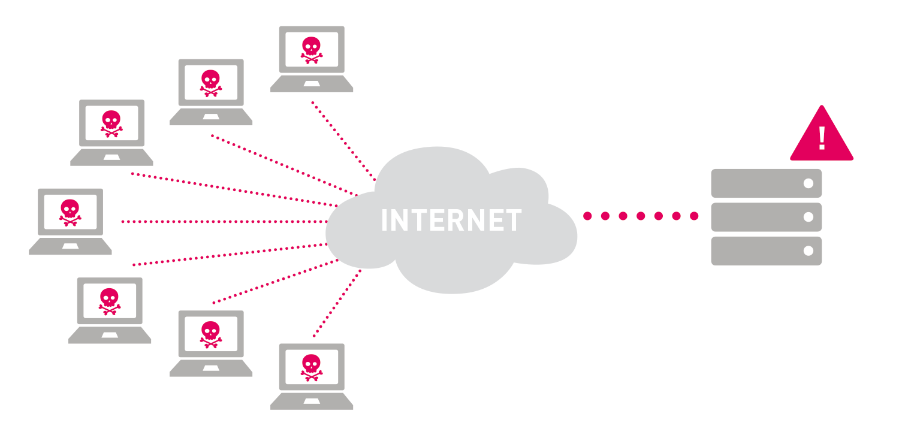
Denial of Service(Dos)
Service Unavailable
Server
Alice

Slide 37
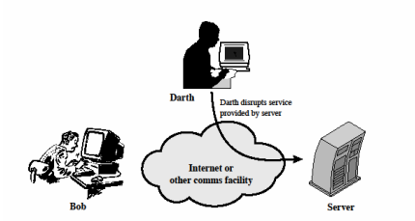
Active Attack Denial of Services

Slide 38
Role of Cryptography
Secure Communication in presence of Adversary
Secure Communication insecure channel

Slide 39
Types of Cryptographic
Cryptographic systems are characterized along three independent dimensions:
The type of operations used for transforming plaintext to ciphertext.
All encryption algorithms are based on two general principles: substitution, in which each element in the plaintext (bit, letter, group of bits or letters) is mapped into another element, and transposition, in which elements in the plaintext are rearranged.
The fundamental requirement is that no information be lost (that is, that all operations are reversible).

Slide 40
Continue…
The number of keys used. If both sender and receiver use the same key, the system is referred to as symmetric, single-key, secret-key, or conventional encryption. If the sender and receiver use different keys, the system is referred to as asymmetric, two-key,or public-key encryption.
The way in which the plaintext is processed. A block cipher processes the input one block of elements at a time, producing an output block for each input block. A stream cipher processes the input elements continuously, producing output one element at a time,as it goes along.

Slide 41



Opponent
Secret Information
Secret Information
“hasdj.sadkdoepsmdlaflasd ;dfkasd kd”
Encoding
Decoding
sender
Receiver
Trusted Third Party
Communication with the use of Cryptography

Slide 42
Continue…
Plain Text – Original Message
Cipher Text - the scrambled message produced as output
Encryption Algorithm - performs various substitutions and transformations on the plaintext
Decryption Algorithm - the encryption algorithm run in reverse
Secret Key - input to the encryption algorithm
The key is a value independent of the plaintext and of the algorithm. The algorithm will produce a different output depending on the specific key being used at the time.

Slide 43
Process of Cryptosystem
In its most basic form, two people, often denoted as Alice and Bob, have agreed on a particular secret key.
At some later time, Alice may wish to send a secret message to Bob (or Bob might want to send a message to Alice).
The key is used to transform the original message (which is usually termed the plaintext) into a scrambled form that is unintelligible to anyone who does not possess the key.
This process is called encryption and the scrambled message is called the ciphertext.
When Bob receives the ciphertext, he can use the key to transform the ciphertext back into the original plaintext; this is the decryption process.

Slide 44
Continue..
A cryptosystem constitutes a complete speciﬁcation of the keys and how they are used to encrypt and decrypt information.
The techniques used by the adversary to attempt to “break” the cryptosystem are termed cryptanalysis.
The most obvious type of cryptanalysis is to try to guess the key.
An attack wherein the adversary tries to decrypt the ciphertext with every possible key in turn is termed an exhaustive key search.

Slide 45
Continue…
When the adversary tries the correct key, the plaintext will be found, but when any other key is used, the “decrypted” ciphertext will likely be random Messages.
So an obvious ﬁrst step in designing a secure cryptosystem is to specify a very large number of possible keys, so many that the adversary will not be able to test them all in any reasonable amount of time.

Slide 46

Symmetric Key Cryptosystem
Plain Text
Cipher Text
Plain Text
Encryption Algorithm
Decryption Algorithm
Alice
BoB
Secret Key
Secret Key

Slide 47
Secret Key Cryptography/ Symmetric Key Cryptosystem
The model of cryptography described above is usually called secret-key cryptography. This indicates that there is one secret key, which is known to both Alice and Bob.
That is, the key is a “secret” that Is known to two parties.
This key is employed both to encrypt plaintexts and to decrypt ciphertexts.
The actual encryption and decryption functions are thus inverses of each other.

Slide 48
Drawbacks of Secret Key Cryptosystem
Alice and Bob must somehow be able to agree on the secret key ahead of time (before they want to send any messages to each other).
This might be straightforward if Alice and Bob are in the same place when they choose their secret key.
But what if Alice and Bob are far apart, say on different continents???

Slide 49
Drawbacks of Secret Key Cryptosystem
If the Key is disclosed, communications are compromised.
Key distribution and management is a serious problem
For N users- O(N²) keys

Slide 50
Public key Cryptography/ Asymmetric Cryptography
Two keys instead of one.
One is Public key and one is private key.
One key would be used to encrypt the message.
Another key would be used to decrypt the message.

Slide 51

Public Key Cryptosystem
Private Key- Alice
Private Key- Bob
Public Key- Alice
Public Key- Bob
Alice
BoB

Slide 52

Public Key Cryptosystem
Alice’s Public key ring
Private Key- Alice
Private Key- Bob
Plain Text
Mike
Plain Text
Jake
Bob
Cipher Text
Encryption Algorithm
Decryption Algorithm
Alice
BoB

Slide 53
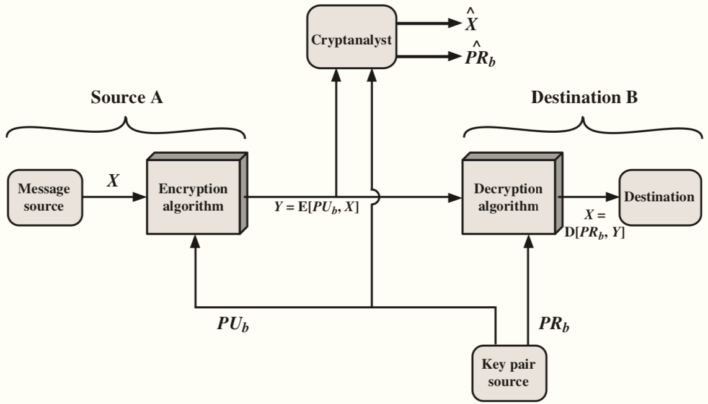
Public-Key Cryptography (for Secrecy)

Slide 54
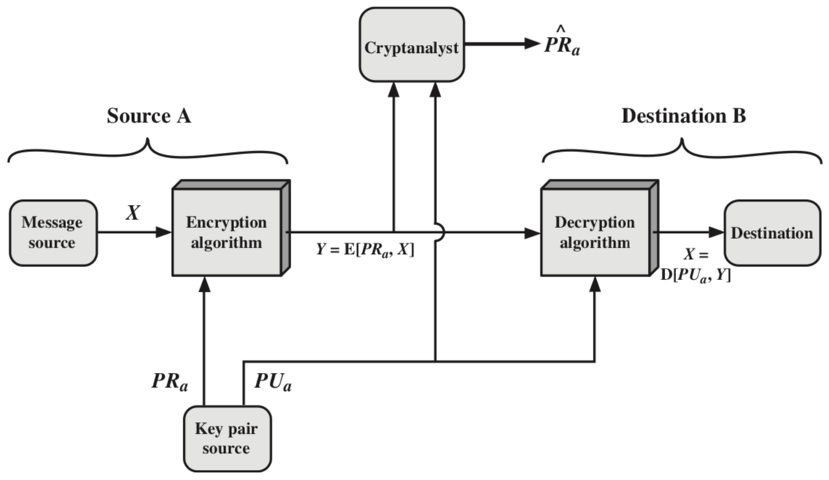
Public-Key Cryptography (for Authentication)

Slide 55
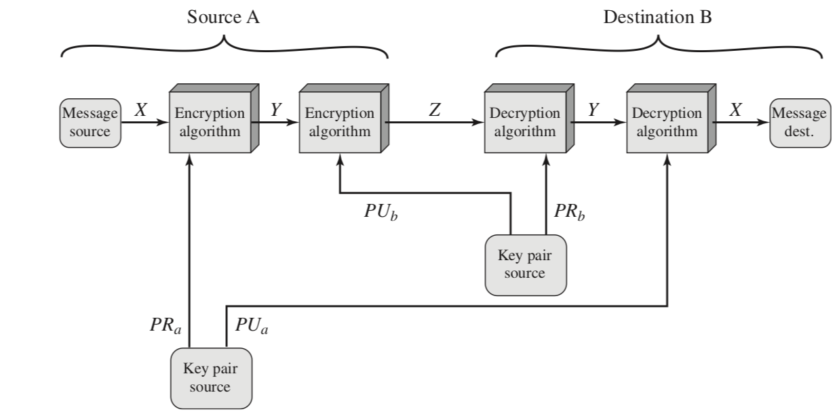
Public-Key Cryptography (for Authentication and Secrecy)

Slide 56
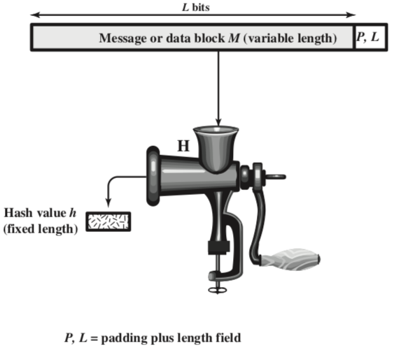
Hash Functions

Slide 57
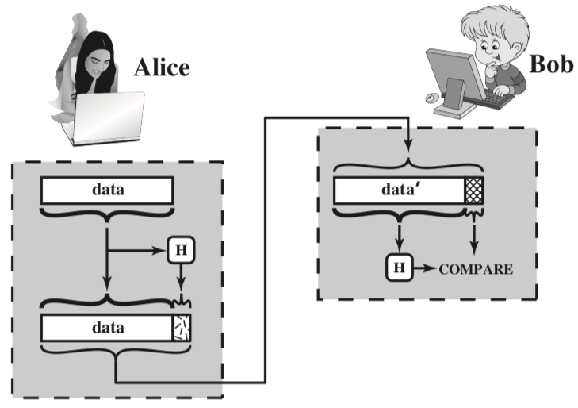
Hash Functions – Integrity Check

Slide 58
Cryptographically Secure hash Functions
Takes any string as an input
Input M: The message
Fixed size output (256 bit in Blockchain, SHA256 used in Bitcoin Blockchain)
H(M) : Output (message digest)
M → H(M) : Efficient
H(M) → M : Difficult

Slide 59
Properties of Cryptographic hash Functions
Collision Free
If two messages are different, their digest will also be different
Hiding
Hide the original message
Puzzle Friendly
Given X and Y, find out K such that Y = H(X||K)
Used to solve the mining puzzle in Bitcoin PoW
It implies that random searching is the best strategy to solve the puzzle

Slide 60
Collision Free
Hash functions are one-way
Given X, it is easy to find H(X)
Given H(X), no deterministic algorithm can find X
It is difficult to find X and Y, such that X != Y and H(X) = H(Y).
Not impossible
Try with randomly chosen inputs to find out a collision, will take too long.
So, we can assume if H(X) = H(Y), then X = Y.
Notes:
It may be easy to find out collision for some hash functions
Birthday Paradox: Find the probability that in a set of randomly chosen people, some of them will have the same birthday
By Pigeonhole Principle, the probability reaches 1 when number of people reaches 366 (not a leap year) or 367 (a leap year)
0.999 probability is reached with just ~70 people, and 0.5 probability is reached with only ~23 people
Birthday paradox places an upper bound on collision resistance
If a hash function produces N bits of output, an attacker can compute only 2^(N/2) hash operations on a random input to find two matching outputs with probability > 0.98
For a 256 bit hash function, the attacker needs to compute 2^128 hash operations
– this is significantly time consuming
If every hash computation takes 1 Millisecond, then it takes 10^28 years

Slide 61
Collision Free
We need to remember just the hash value rather than the entire message – we call this as the message digest.
To check if two messages X and Y are same, X = Y, then check whether H(X) = H(Y)
This is efficient because the size of the digest is significantly less than the size of the original messages
Notes:
It may be easy to find out collision for some hash functions
Birthday Paradox: Find the probability that in a set of randomly chosen people, some of them will have the same birthday
By Pigeonhole Principle, the probability reaches 1 when number of people reaches 366 (not a leap year) or 367 (a leap year)
0.999 probability is reached with just ~70 people, and 0.5 probability is reached with only ~23 people
Birthday paradox places an upper bound on collision resistance
If a hash function produces N bits of output, an attacker can compute only 2^(N/2) hash operations on a random input to find two matching outputs with probability > 0.98
For a 256 bit hash function, the attacker needs to compute 2^128 hash operations
– this is significantly time consuming
If every hash computation takes 1 Millisecond, then it takes 10^28 years

Slide 62
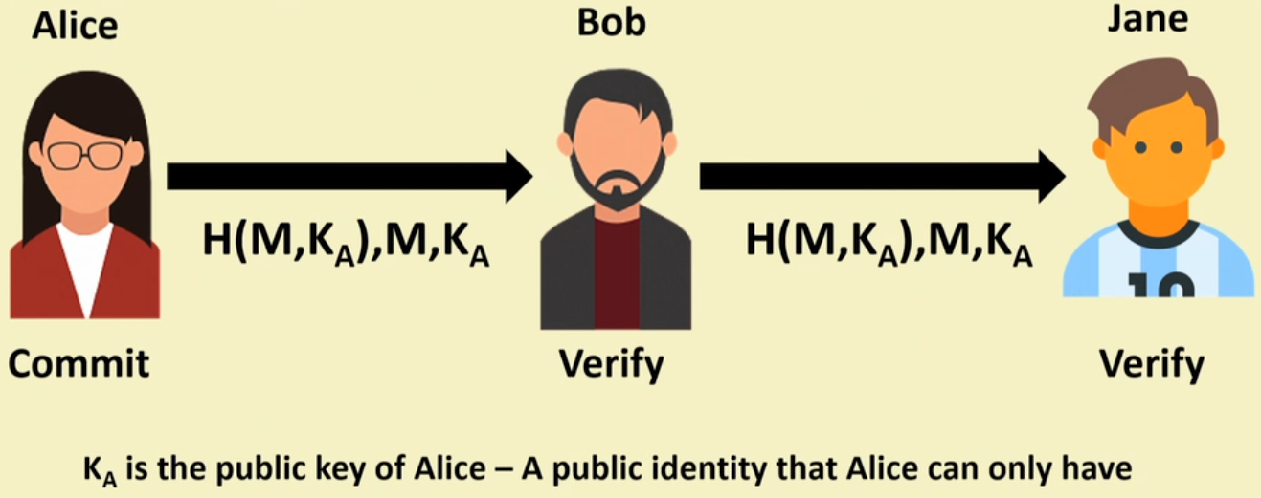
Message Commitment using Secure Hash Functions

Slide 63
SHA256
Pad the message such that the message size is multiple of 512
Suppose that the length of the message M is L and L mod 512 != 0
Append the bit “1” at the end of the message
Append K zero bits, where K is the smallest non-negative solution to the equation L + 1 + K = 448 mod 512
Append the 64-bit block which is equal to the number L written in binary
The total length gets divisible by 512
Parse the message into N 512-bit blocks ,M⁽¹⁾ , M⁽²⁾ …, M^{(N)}
Every 512 bit block is further divided into 32 bit sub-blocks , M₀^{(i)} ,…, M₁₅^{(i)}

Slide 64
SHA256
The message blocks are processed one at a time
Start with a fix initial hash value H⁽⁰⁾
Sequentially compute H^{(i)} = H^{(i-1)} + C_{M(i)} H^{(i-1)}
C is the SHA-256 compression function
+ means 2 ³² mod addition.
H^{(N)} is the hash of M.

Slide 65
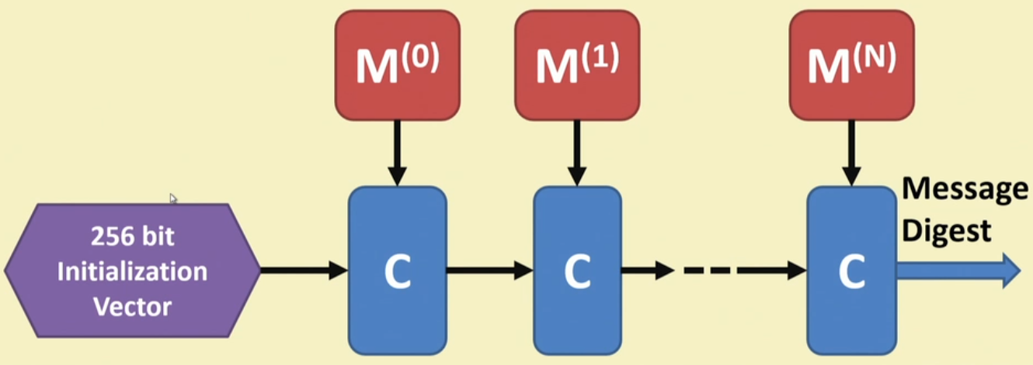
SHA256

Slide 66
Hash Pointer
It is a pointer to a location where
some information is stored
Hash of the information is stored
With the hash pointer we can
Retrieve the information
Check that the information has not been modified.
By computing the message digest and then matching the digest with the stored hash value.

Slide 67
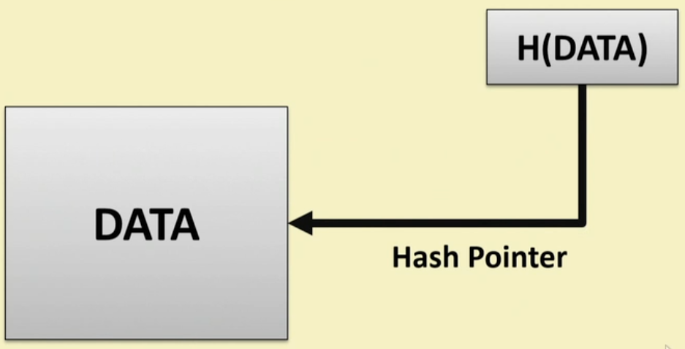
Hash Pointer

Slide 68
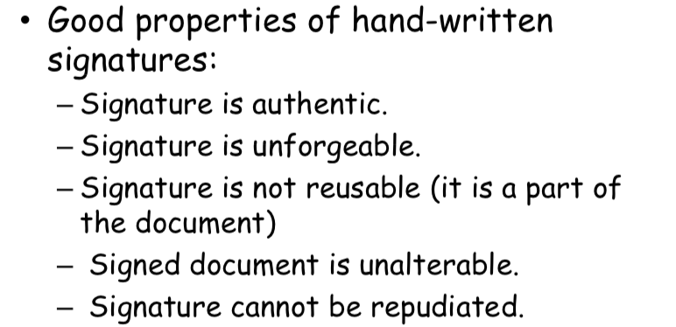
Required Properties for Good Signature

Slide 69
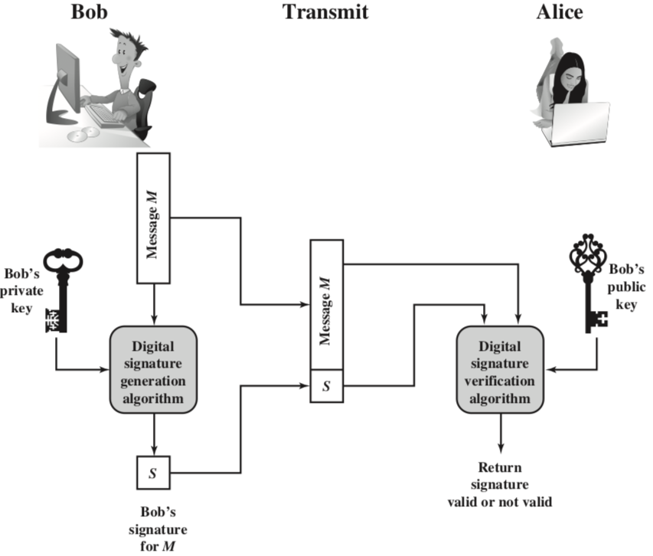
Digital Signature

Slide 70
Digital Signature
It is a digital code, which can be included with an electronically transmitted document to verify
The content of the document is authenticated
The identity of the sender
Prevent non-repudiation
Sender will not be able to deny about the origin of the document

Slide 71
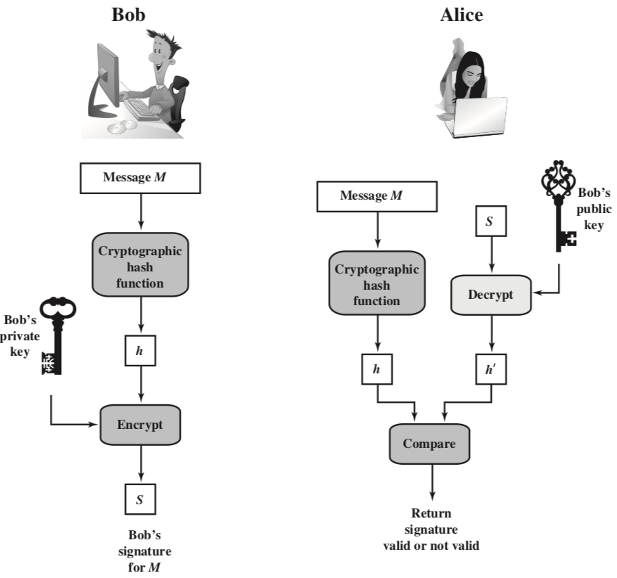
Digital Signature

Slide 72
Digital Signature
Only the signing authority can sign a document, but everyone can verify the signature
Signature is associated with the particular document
Signature of one document cannot be transferred to another document

Slide 73
What we use in Blockchain?
Cryptographically Secure hash Functions
Used to Connects the blocks in a tampered proof way
Digital Signatures
Digitally sign the data so that no one can deny about their own activities

Slide 74
Thank You

Slide 75
References
Behrouz A. Forouzan. 2007. Cryptography & Network Security, McGraw-Hill, Inc., USA.
William Stallings. 2010. Cryptography and Network Security: Principles and Practice (5th. ed.). Prentice Hall Press, USA.

